Slide 1
Transport of Glucose
By
Professor
Dr. Jamal Ahmed Abdul-Barry

Slide 2
TRANSPORT OF GLUCOSE
Glucose cannot diffuse directly into cells, but enters by one of
two transport mechanisms:
a Na⁺-independent facilitated diffusion transport system.
or
a Na⁺-monosaccharide co-transporter system.

Slide 3
1. Na⁺-independent facilitated diffusion transport system
This system is mediated by a family of at least fourteen
glucose transporters in cell membranes.
They are designated to GLUT-1 to GLUT-14
Glucose transporter 1 to 14.
These transporters exist in the membrane in two conformational
states.

Slide 4
Extracellular
1.Glucose binds to the transporter.
2. Alters its conformation, transporting glucose across the cell
membrane.

Slide 5
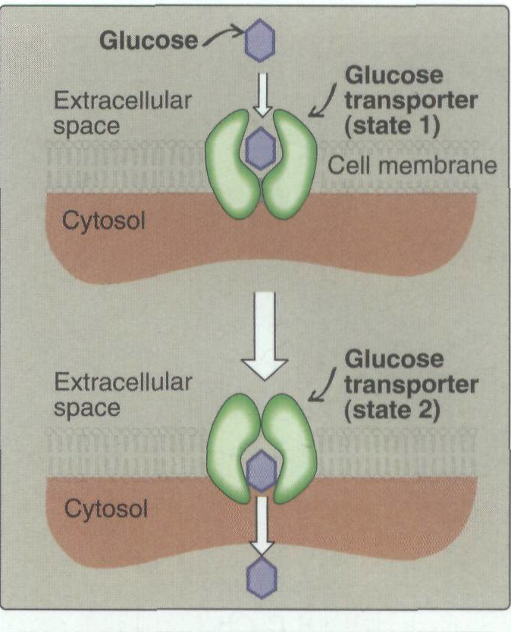
Conformational States of Glucose transporters

Slide 6
1. Tissue specificity of GLUT gene
The glucose transporters display a tissue-specific pattern of expression.
For example:
GLUT-3 : Is the primary glucose transporter in neurons.
GLUT-1:
Is abundant in erythrocytes and brain, but is low in adult muscle.
GLUT-4: Is abundant in adipose tissue and skeletal muscle.
Note: The number of GLUT-4 transporters active in these
tissues is increased by insulin.

Slide 7
2. Specialized functions of GLUT isoforms
In facilitated diffusion, glucose movement follows a concentration gradient, that is, from a high glucose concentration to a lower one.
For example, GLUT-1, GLUT-3, and GLUT-4 are primarily involved
in glucose uptake from the blood.
In contrast ,GLUT-2, which is found in the liver, kidney, and β cells of the pancreas, can either transport glucose into these cells when blood glucose levels are high, or transport glucose from the cells to the blood when blood glucose levels are low (for example, during fasting).

Slide 8
GLUT-5 is unusual in that it is the primary transporter for fructose (instead of glucose) in the small intestine and the testes.
GLUT-7, which is expressed in the liver and other gluconeogenic tissues, mediates glucose flux across the endoplasmic reticular membrane.

Slide 9
2. Na+-monosaccharide cotransporter system
This is an energy-requiring process that transports glucose "against " a concentration gradient that is, from low glucose concentrations outside the cell to higher concentrations within the cell.
This system is a carrier-mediated process in which the movement of glucose is coupled to the concentration gradient of Na⁺ which is transported into the cell at the same time.
This type of transport occurs in the epithelial cells of the intestine, renal tubules, and choroid plexus.

Slide 10
Thank You

